Slide 1
Water We Going to Do?
Grangemouth Flood Protection Scheme STEM Activity

Slide 2
Lesson 1
Slides 2 - 12

Slide 3
Learning Intentions, Lesson 1
We are learning about some of reasons flooding happens.
We are looking at some of the consequences of flooding.
We are learning about some of the roles involved in a large-scale infrastructure project.
We are thinking about how our own skills and interests might influence our choice of job.

Slide 4
Success Criteria, Lesson 1
I can describe some of the reasons floods occur, both on a local and global scale.
I can explain some of the consequences of flooding and give some examples.
I can identify the roles involved in a flooding project and explain some aspects of their job.
I can select an appropriate role for myself and explain why I think I would be a good candidate for this role.
I can consider the skills of others and work with my group to assign project roles.

Slide 5
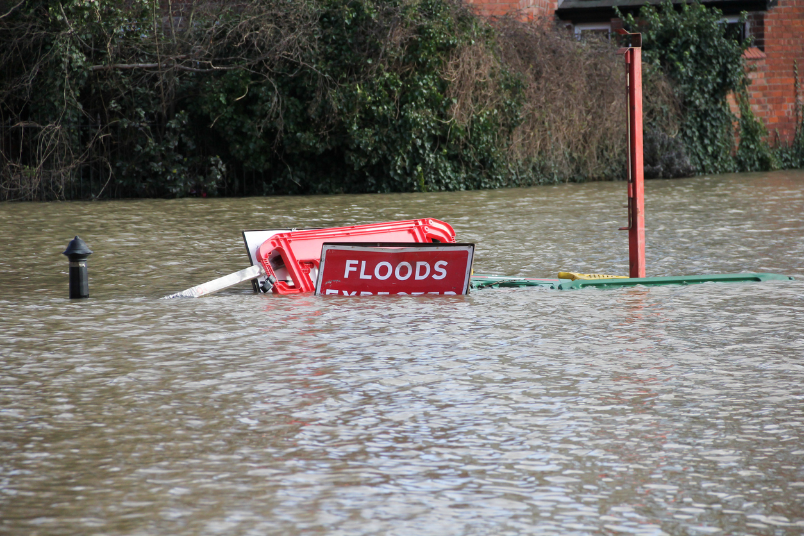
What do we know?
Key Questions:
What is a Flood?
Can you think of any famous floods?
Is flooding good or bad?
Notes:
Ask the class if they know what is a ‘Flood’?
Can they think of any famous floods that they may have heard of? Some examples might be ‘Noah’s Ark’, recent floods in Scotland/wider UK etc.
Is flooding a positive or a negative thing?
This depends on the circumstance and the management available. In some situations flooding can be devastating if it happens in areas where people live OR in many East Asian Countries, for example, the ‘paddy’ fields are deliberately flooded in order to grow rice as it kills of the weeds that would otherwise eat the crops, but without harming the rice plants.

Slide 6
Falkirk STEM Box Resources
To learn more about:
What is flooding and why it happens
Falkirk floods, past and present
Why settle near the water
An introduction to Civil Engineering and flood defences
Please use the Falkirk STEM box resources. These can be found here
Please note, these are a separate, additional resource, and are not required to successfully complete this programme.

Slide 7
Group Name
Notes:
Team Counting Exercise:
It is important that the group establish a good ‘team’ ethos and can recognize the importance of each member’s contribution.
Explain that they are being challenged to work as a team.
Ask everyone in the group to close their eyes (the rest of the class can keep theirs open but everyone must stay totally silent). The aim of the game is to count to 20, in order, with everyone in the team contributing at least one number and no one saying more than one in a row.
Because their eyes are closed they can’t tell when another person is about to speak so they must try to read the group in other ways.
This can either be used simply as a bonding exercise or, as a competition, with the group to get to 20 fastest, within the rules, being the winner.
Once all groups have completed the challenge spend some time emphasising the learning of the group working as a team and the fact that each team member fulfilling their role is vital for the process to work.
Team Name:
Hand each group an A3 copy of Appendix F – Group Worksheet.
Ask them to take 5 minutes to come up with an inspiring team name that includes all members in some way. This might be an anagram of their initials, a favorite animal, food or colour that they have in common.
Take a couple of minutes to go over the team names and seek an explanation for them that explains how everyone has been included.

Slide 8
Skills Wheel
Notes:
Skills Wheel:
Hand out one skills wheel to each group (printed in A3 size) and post-its (1 blue and 1 red per person)(Torn up paper will work if no post-its available)
Ask the group to stand in a circle, or, sit around a table in a circle or rectangle. (it’s important that the all have someone to their right and it’s clear who that person is).
Using the ‘Skills Wheel’ ask the group to take one red and one blue post-it each. On the red one write their initials. On the blue one write the initials of the person to their right.
Without talking ask the group to think about which section of the wheel they would best fit on and why. It’s important that they are able to explain their decision by giving examples of times when they’ve demonstrated this skill.
It is important to emphasise that everyone has many skills and this is just thinking about one key skill that they either enjoy, are good at or, would like to further develop.
Now ask that they do the same for the person who’s initials they have written on their blue post-it. Can they think of evidence that backs up their thinking?
Finally, ask that they place the red and the blue post-its on the sections of the wheel that they have decided on.
Provide some opportunity for group discussion around WHY they selected the sections they did and an opportunity for them to evidence their thinking. It is important to emphasis that this evidence and explanation should focus on positive examples only.

Slide 9
Job Roles
Notes:
Look at the Job Roles described.
Invite questions/discussion from the class around:
Have they heard of this role before?
Can they think of the types of skills that might be helpful in this role?
What do they think might be the best/most challenging aspects of this role?
Ask them to consider; silently, which member of the group might be best suited to each role.
Ask each group to look out their A3 copy of Appendix F – Group Worksheet and a pad of post-its (or torn-up paper)
Ask that the young people carefully consider which member of their group would be most appropriate for each role. They should be able to justify their answers based on evidence and their previous learning around the personality traits of the group. They should include themselves in this process.
Ask the young people to write the initials of each member of their group on the back/sticky side of their post-its (or the back of the torn-up paper) with one set of initials per post-it. Then, place one post-it on each role; with the initials of the person they feel would be most appropriate for that role, including their own initials.
After every group has finished (you may wish to set a timer or stopwatch for this) provide some time for the group to reveal and discuss the results. There may be an obvious candidate for each role, or there may be some difference in opinion. The challenge will be for pupils to come to a decision amongst themselves and assign one person to each roll.
They can then report these results to the whole class, explaining the decisions they came to and why.
Explain to the class that the task next time will be to build on what they have learned in this lesson by working within their groups, in the jobs they have been allocated, to research and devise their own flood protection strategy.

Slide 10
Learning Intentions, Lesson 1
We are learning about some of reasons flooding happens.
We are looking at some of the consequences of flooding.
We are learning about some of the roles involved in a large-scale infrastructure project.
We are thinking about how our own skills and interests might influence our choice of job.

Slide 11
Success Criteria, Lesson 1
I can describe some of the reasons floods occur, both on a local and global scale.
I can explain some of the consequences of flooding and give some examples.
I can identify the roles involved in a flooding project and explain some aspects of their job.
I can select an appropriate role for myself and explain why I think I would be a good candidate for this role.
I can consider the skills of others and work with my group to assign project roles.

Slide 12
Plenary
Head Heart
Bag Bin
Notes:
Freeze the board so that it won’t move if touched or draw this grid on a whiteboard.
Explain that:
Head means something that made you think during the activity and would now like to look into further during your upcoming research
Heart means something you really enjoyed
Bag means something you will remember
Bin means something you won’t be taking further in your research
Hand out 4 post-it to each group and ask them to complete 1 for each section on the slide. Post-its can be kept to inform future learning.
Allow time for questions

Slide 13
Lesson 2
Slides 13 - 21

Slide 14
Learning Intentions, Lesson 2
We are learning to identify some of the strategies used in flood protection
We are conducting research into the pros and cons of each of these strategies
We are fulfilling assigned roles as part of our team
Notes:
Discuss these with the class and clarify any unfamiliar terms or concepts.
Can learners remember:
Some of the flood protection strategies discussed?
Their role, and the roles of others, on their team?
Ask the young people to look out their notes from the previous lesson/session and use these to help inform their research.
Note: as this lesson can take place over several sessions it can be helpful to have a re-cap at the beginning of each session to re-focus and remind the young people what their focus and goals should be at the beginning of each session to ensure they remain focused. It is best to be as explicit as possible about the number of sessions the young people will have in which to conduct their research so that they can plan accordingly.
At this stage the pupils are simply exploring the options available and researching some of the issues that these options might cause, as well as identifying the key benefits of each option. They are not yet at the point of identifying their specific solution but are gathering the information required to help them do so.

Slide 15
Success Criteria, Lesson 2
I can identify 3 specific strategies involved in flood protection
I can use the internet and other sources to research flood protection strategies and am able to explain some of the pros and cons of these strategies
I can explain what my role within the team is and can describe the ways in which I am fulfilling this role as part of my team

Slide 16
SMART Goals for the Session
S – Specific
M – Measurable
A – Achievable
R – Relevant
T – Time Bound
Notes:
If this lesson is being completed as a series of sessions, ask each group to meet and discuss 3 objectives for this session. For example, they may want to:
Find out more about one specific flood protection strategy that they’d like to use as part of their scheme.
Investigate the counter-arguments they might come up against when using this strategy.
Look into some interventions on how to manage stakeholder concerns and other constraints
Encourage them to set ‘SMART’ goals (Specific, Measurable, Achievable, Relevant and Time bound)
Ask them to also think ahead to what their goals might be for the next/future sessions so that they can include this information as part of their planning.

Slide 17
Flood Protection Information Videos
Video | Length | Link
Introduction | 46s | Introduction by Adele Jaccon on Prezi Video
Flood Walls | 2min 52s | Flood Walls by Adele Jaccon on Prezi Video
Embankments | 2min 4s | Flood Embankments / Levees by Adele Jaccon on Prezi Video
Flood Gates | 2min 9s | Flood Gates by Adele Jaccon on Prezi Video
Flood Storage Areas | 2min 7s | FSAs by Adele Jaccon on Prezi Video
Flood Relief Channels | 1min 52s | FRCs by Adele Jaccon on Prezi Video
Culverts | 1min 55s | Culverts by Adele Jaccon on Prezi Video
Top Tips | 1min 32s | Top Tips by Adele Jaccon on Prezi Video
Notes:
You may wish to use these videos on their own or in combination with the differentiated Pupil Worksheets and/or Pupil Research or Assessment PowerPoint. It’s up to you to select the best research method for your class.

Slide 18
Feedback
What did we learn?
How will this influence our design?
What do we need to find out more about?
What are our next steps?
Notes:
Ask the teams to create a plan for the time available. Be clear about how much time they have; remembering to allow for time to get logged-on and pack up etc.
When planning, the groups need to specify which member of the team is doing what and what results they hope to achieve by the end of the session. For example:
They might sub-divide into several groups of 2 and look at one strategy each
They might stay together as a team and use different methods of research to investigate one strategy (specific websites etc)
Explain that, in the STEM industries, this is a vital part of the process of any project as the client needs to receive regular information on how the project is going and the plans going forward.
At the end of the session allow time for the groups to feed back what they have explored and what their plans are for the next session. They may wish to do this to you as a teacher rather than to the whole class if they are beginning to form their own ideas about their final design so as not to give away their findings to other groups.
Create an open dialogue with the class regarding how much time is left for research in further sessions, if any, and try to establish when they feel they have achieved the Success Criteria for this lesson and are ready to move on to the final lesson. Ideally all groups would be ready to move on at the same time, but this may not be the case.

Slide 19
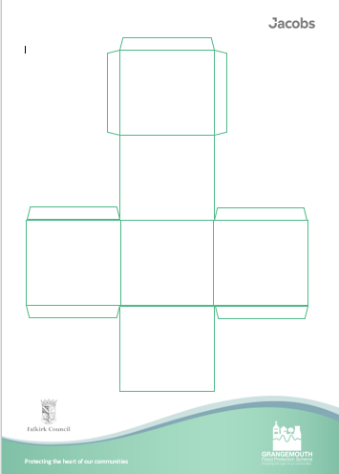
Plenary, Question Dice
Notes:
Plenary
Hand out a dice to each group. Ask them to write a question on each face of the dice relating to flood protection strategies.
Once all groups have filled each face of their dice pass them to group to their right to answer the questions they’ve set by rolling the dice and answering the question on the top face of the dice.

Slide 20
Learning Intentions, Lesson 2
We are learning to identify some of the strategies used in flood protection
We are conducting research into the pros and cons of each of these strategies
We are fulfilling assigned roles as part of our team

Slide 21
Success Criteria, Lesson 2
I can identify 3 specific strategies involved in flood protection
I can use the internet and other sources to research flood protection strategies and am able to explain some of the pros and cons of these strategies
I can explain what my role within the team is and can describe the ways in which I am fulfilling this role as part of my team

Slide 22
Lesson 3
Slides 22 - 32

Slide 23
Learning Intentions, Lesson 3
We are learning to consolidate our ideas and select one flood prevention strategy, including where on the map this should be used, based on the research we have completed
We are learning to answer questions or concerns about our choice and explain our thinking
We are learning how to adapt our solution to suit the needs of the community

Slide 24
Success Criteria, Lesson 3
We can bring together our research and use it to help use select and apply one flood protection strategy
We can answer questions about our choice and explain why we made the decisions we made
We can adjust our solution to accommodate what the judges are looking for

Slide 25
Check-in
How do you feel your research went?
Do you feel you achieved your objectives and gathered enough information?
How are you feeling about your roles within the team?
How could you support one another to fulfill these even more successfully?
Notes:
Note – this can be completed as a whole class or, if one group is ready to move on before the others, with that group alone. Similar to the last lesson, it can occur over one, or several sessions depending on the time available/required. The lesson is complete when the group have achieved the SC and feel ready to showcase their design to the judges.

Slide 26
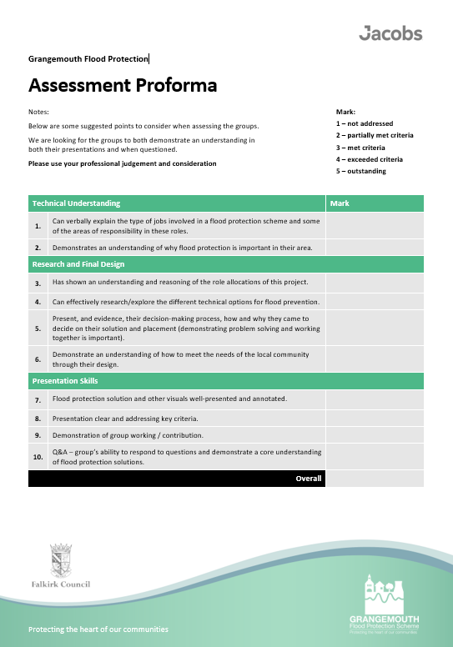
Judges Criteria
Notes:
Discuss the criteria and go over any unfamiliar words/terms. Ask the group to consider these criteria throughout their planning for their design and use them to illustrate their explanation/presentation for their design for the judges.

Slide 27
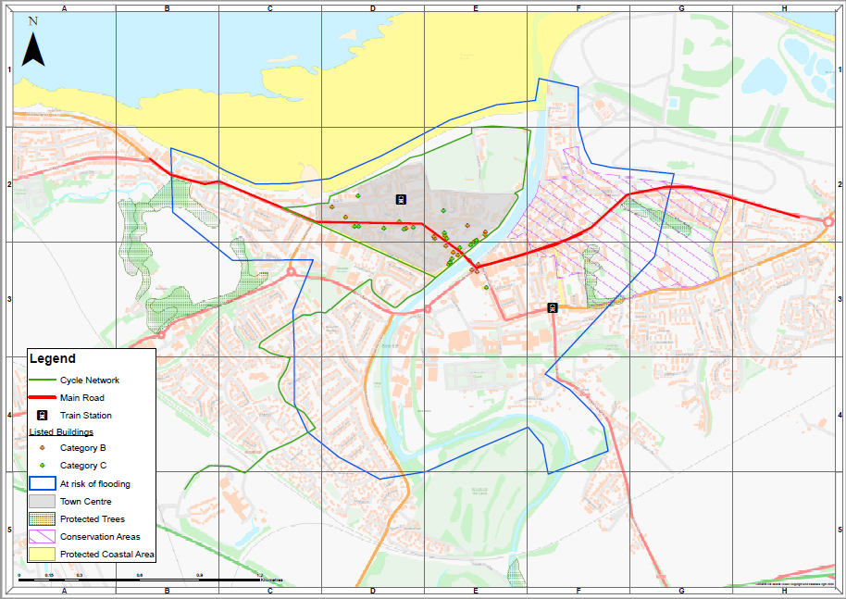
Design Options
Options:
Paper, cardboard pens
Junk for modelling with
Clay/playdough or other modelling materials
Videos/PowerPoints or other digital technology
Photos, drawings or illustrations
Other
What are the pros and cons of each?
What will you choose?
Notes:
Explain that the young people can illustrate/explain their designs in whatever way they wish OR in whichever way suits the resources/equipment available in the class.
If the solution is clearly showcased and explained, and the young people can discuss their solution, their thinking and answer any questions around it then any materials they/you choose to use are suitable.
Discuss the resources are available in the classroom (or at home if junk modelling) to model/illustrate/demonstrate their solution.
Give the groups 5 minutes to consider which materials they want to use and what they need to do to source them. For example, if they want to use paper an pens or PowerPoint then these may be easily available within the school, however if they would like to use junk modelling and require specific items for this then they may need to consider how to source these. (Note, this may evolve as their solutions do but having an initial starting point is helpful)
As in the previous lesson, it is important that learners know how many sessions are available to them and that they carefully plan how to use these sessions to make the most of the time available. Setting SMART Goals for each session is a good way to ensure the groups stay focused so you may with to use this as an additional tool. Ensure that they relate these goals to the judging criteria will give them a starting point too.

Slide 28
SMART Goals for the Session
S – Specific
M – Measurable
A – Achievable
R – Relevant
T – Time Bound
Notes:
Groups work on developing their final ideas, models/descriptions/presentations and try to ensure that they are as informed as possible to be able to answer any questions from the judges.
They then film their finished presentations, including the teacher-selected judges' questions. Please refer to the Judging Pack and FAQs for more information.

Slide 29
How are we getting on…
Notes:
At the end of each session the group can come back together and discuss if their progress in relation to the targets set, as well as setting new targets. They may want to be vague as to what the targets were, when discussing them with the whole class, so as not to give away their ideas, but they can be specific about how well they felt they met them.
The group are ‘finished’ when they are able to showcase and explain their design, as well as answer questions about it. Their explanations should cover how their design works as well as how it meets the judge’s criteria.

Slide 30
Practice
Remember:
Be clear
Be confident
Explain your thinking
Be ready to answer the judges Questions
Notes:
To practice for the final event you may wish to run a trial session for the groups during which they present their designs as they plan to do for the judges. This could be for an audience of their peers/school staff/other classes. They can then receive feedback and adjust their model in advance of the final session in front of the judges.

Slide 31
Learning Intentions, Lesson 2
We are learning to identify some of the strategies used in flood protection
We are conducting research into the pros and cons of each of these strategies
We are fulfilling assigned roles as part of our team

Slide 32
Success Criteria, Lesson 2
We can bring together our research and use it to help use select and apply one flood protection strategy
We can answer questions about our choice and explain why we made the decisions we made
We can adjust our solution to accommodate what the judges are looking for

Slide 33
Good Luck!
We are looking forward to seeing your finished designs!

