Slide 1
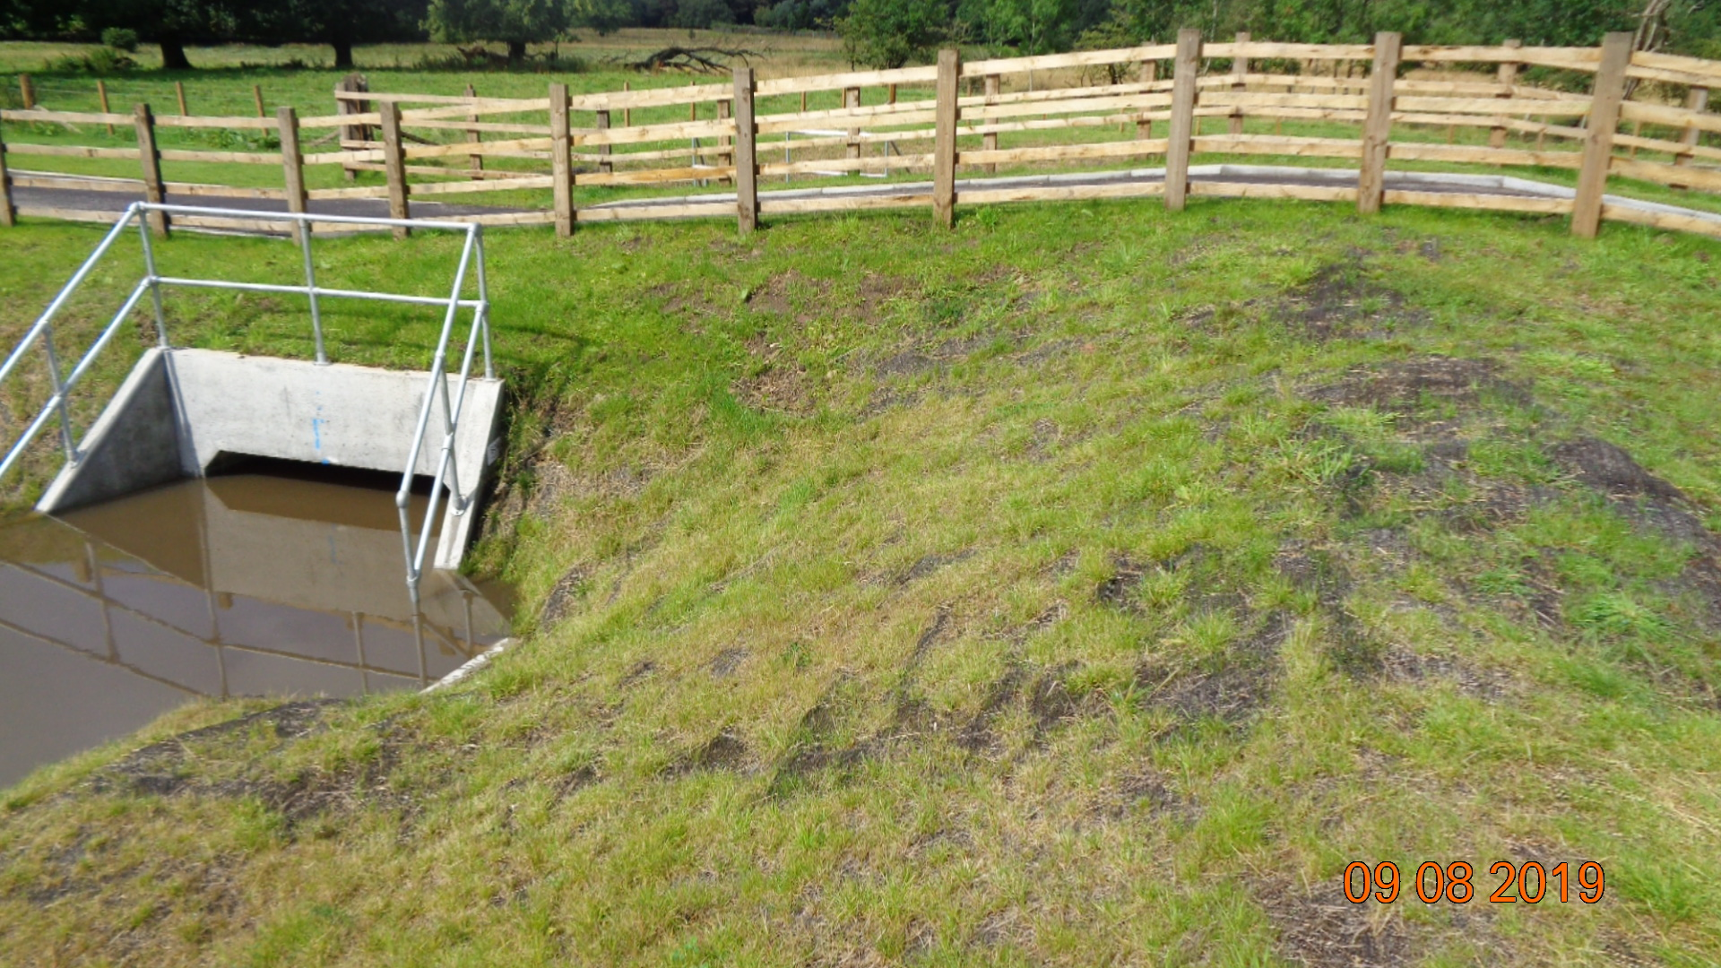
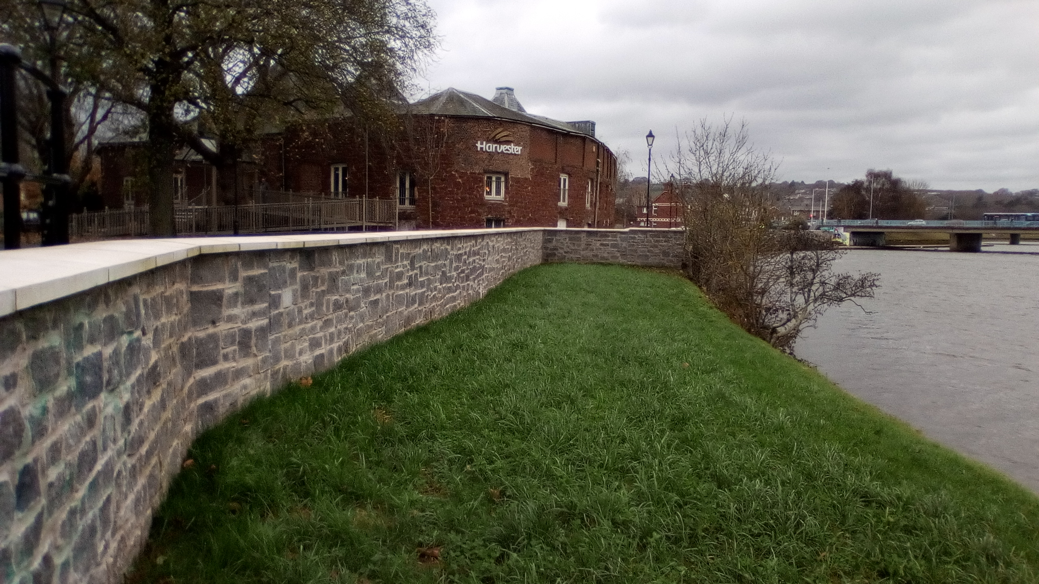
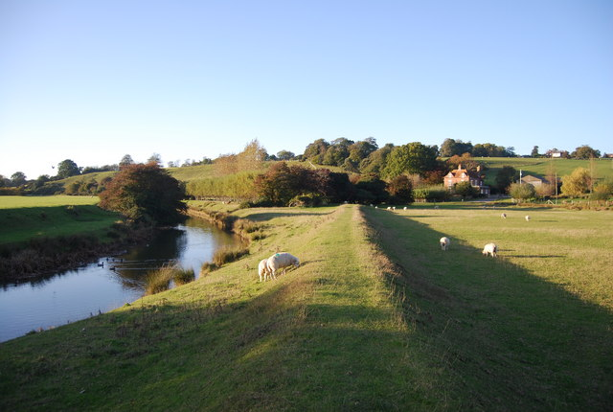
Match the FLOOD PROTECTION SCHEME to the PICTURE…
1
Floodwall
Flood Embankment / Levee
2
Vehicle or Pedestrian Flood Gate
Flood Storage Area
3
Flood Relief Channel
Culvert

Slide 2
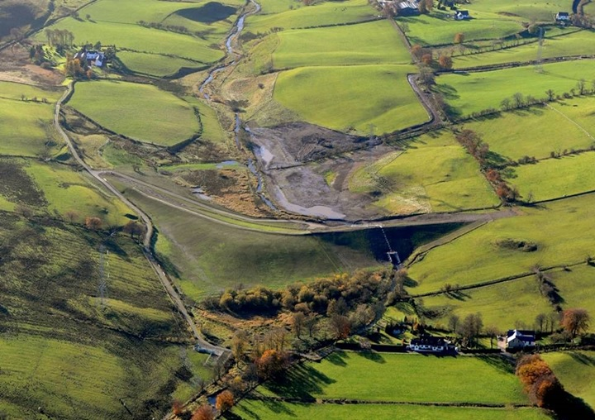
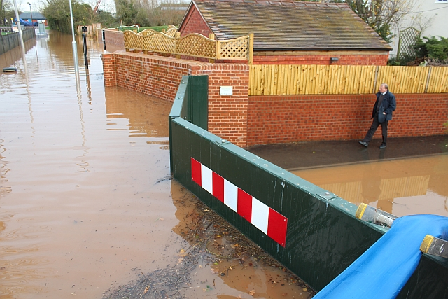
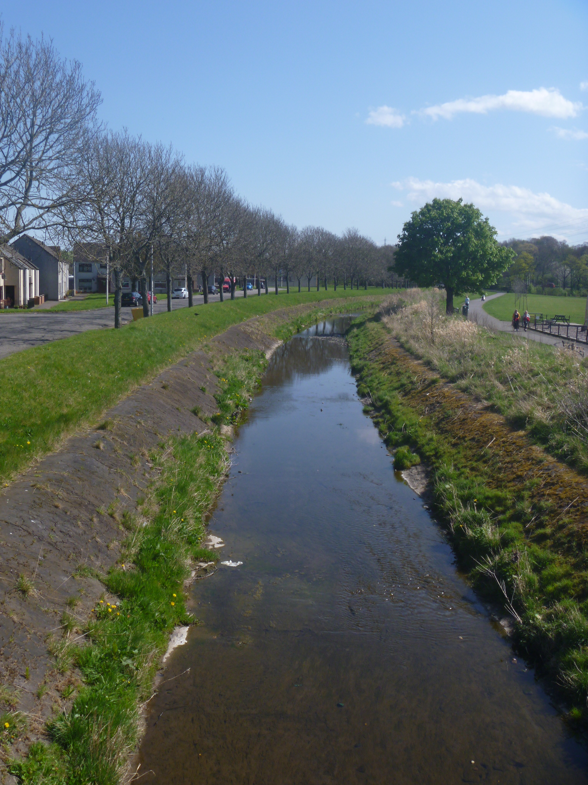
Match the FLOOD PROTECTION SCHEME to the PICTURE…
4
Floodwall
Flood Embankment / Levee
5
Vehicle or Pedestrian Flood Gate
6
Flood Storage Area
Flood Relief Channel
Culvert

Slide 3
MATCH the BENEFITS and ISSUES to the FLOOD PROTECTION SCHEMES
Flood Embankment / Levee
Floodwall
Culvert
Benefits…
Issues…
Doesn't require much space to be built
Can be made to look attractive (stone/brick clad)
Can be made to be removable (more expensive)
Doesn't allow human or animal passage through/over them
Shorter design life since materials might need replacing after a while (design life of concrete is 50-100 years only)
If made to be removable they need to be installed manually before a flood (this process can be very risky)

Slide 4
MATCH the BENEFITS and ISSUES to the FLOOD PROTECTION SCHEMES
Flood Embankment / Levee
Floodwall
Culvert
Benefits…
Issues…
Prevents erosion (gradual destruction) of the river and its banks if designed correctly
Ensures water does not flow over ground (for example through people's gardens or over roads)
Can be used to divert water for farming or engineering purposes
Must be correctly designed to avoid scouring (destruction of the riverbed) and corrosion
Needs to include something to allow aquatic animals to pass through (for example fish passages)
Needs constant maintenance (cleaning it of any debris or sediment, replacing fish brushes etc)

Slide 5
MATCH the BENEFITS and ISSUES to the FLOOD PROTECTION SCHEMES
Flood Embankment / Levee
Floodwall
Culvert
Benefits…
Issues…
Can be made to blend in with nature if covered in grass.
Can provide natural habitat for riverbed animals if built with earth
A path can be constructed on top to allow people to walk/cycle on it
Requires regular maintenance (for example cutting the grass, reforming after a flood in case material was washed away)
Needs a lot of space to be built
Needs to account for local drainage (for example what would happen downstream to other towns if more water is forced towards them)

Slide 6
MATCH the BENEFITS and ISSUES to the FLOOD PROTECTION SCHEMES
Vehicle / Pedestrian Flood Gate
Flood Storage Area
Flood Relief Channel
Benefits…
Issues…
Reduces the need to build defences against flood further downstream
Don’t need to account for local drainage since the water can be released back into the river at a controlled safe pace
Can be incorporated into the scenery
Expensive to build and maintain
High risk if anything goes wrong so must be constantly surveyed
Floods a large area to hold the water which means the land cannot be use until the flood is over

Slide 7
MATCH the BENEFITS and ISSUES to the FLOOD PROTECTION SCHEMES
Vehicle / Pedestrian Flood Gate
Flood Storage Area
Flood Relief Channel
Benefits…
Issues…
Don’t need to account for local drainage or the river losing water
New aquatic habitats are created
Doesn’t affect people living close to where defences would have originally been built
Required constant maintenance (for example regular cleaning)
Needs a lot of space
Should be designed to ensure it wont cause flooding along the new channel

Slide 8
MATCH the BENEFITS and ISSUES to the FLOOD PROTECTION SCHEMES
Vehicle / Pedestrian Flood Gate
Flood Storage Area
Flood Relief Channel
Benefits…
Issues…
Easy to replace
Demountable (meaning it can be removed and stored somewhere); this can be useful if access to the other side of the walls is needed
A lot of colours/finishes/sizes available so can blend in with the local landscape
The gate must be completely secure against the ground for the seal to work
Might need to be closed manually every time a flood is announced (more expensive models are automated now)
Must be stored somewhere safe when not in use (only is it is a manual gate)

